Slide 1


Basic UNIX Workshop
Volos Summer School
30 / 05 / 2017
Konstantinos Hatzikotoulas

Slide 2
What is UNIX
UNIX is an operating system family (analogous to DOS and Windows)
first developed in the 1960s
operating system, (OS)= suite of programs which make the computer work. It is a stable, multi-user, multi-tasking system for servers, desktops and laptops.

Slide 3
The UNIX operating system
UNIX itself is not used anymore
Linux (Fedora, Arch, Ubuntu, Red Star Linux) is its successor
UNIX-based systems do not rely on a graphical interface
With UNIX, you don’t use the mouse!
Linux often comes with a window-manager and advanced graphical support, but advanced users still use a terminal emulator

Slide 4
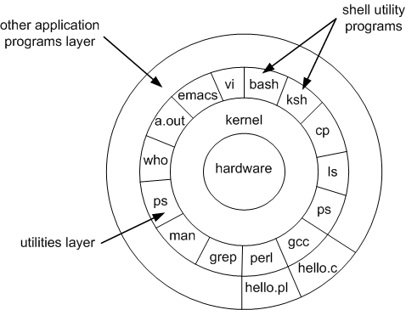
The UNIX operating system
The kernel is the core of the OS, the part that interacts with the processor, memory…
The shell is what you see when you open a command line. It allows the user to interact with the kernel.
The shell has only a few basic commands (mostly file management). Other applications can be built to interact with the kernel and can be called in the shell.

Slide 5
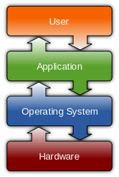
What happens when I type a command?

Slide 6
The command line
Every action has to be typed on the screen and sent to the system with Enter
You are always in a directory, every command you send will affect the current directory unless stated otherwise
Remember where
you are!

Slide 7
The command line
It is now forgotten, but all historical computers ran on text-only interfaces (MS-DOS before Windows, OS/2 before Mac OS)
They are really useful for file and data manipulation
On Windows, we use emulators (which imitate UNIX behaviour) and remote access programs (which connect to real UNIX systems)

Slide 8
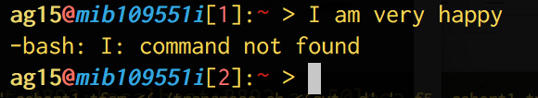
The command line
When you send a command, the system will look it up
If it is a system command, it will execute it itself
If not, it will look if it’s a third-party program installed on the computer
If not, it will yell at you.

Slide 9
The command line
user1@host:~$ find –iname “*.txt”
What the computer writes
« the command prompt »
The arguments
« these are my criteria »
The command
« find a file that match certain criteria »

Slide 10
The command line
You have to remember all the useful commands (or look them up on the internet)
You have to remember all the arguments for every command
If you remember the name you can get help about the arguments
Most commands have a “help me” argument
There is a command that tells you how to run other commands:
user1@host:~$ find –-help
user1@host:~$ nano –h
user1@host:~$ man find

Slide 11
The command prompt
user1@host:~$
Username @ name of the computer : current directory $

Slide 12




Command input
Filename Completion
History +

Slide 13
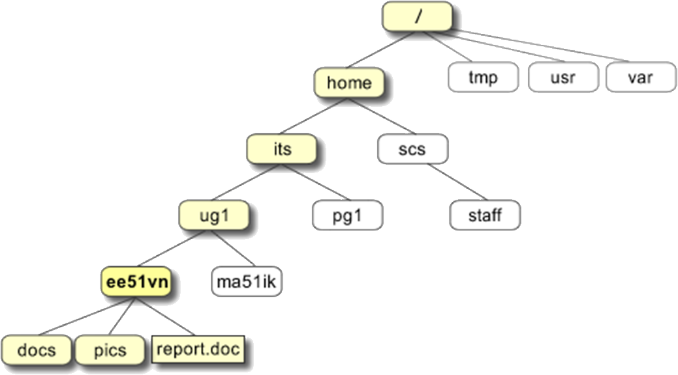
Directory Structure
If you are user “its”, you will land here when opening your session
This directory is your “home” directory, designated by the character “~”

Slide 14
Directory Structure
The full path to the file report.doc is
"/home/its/ug1/ee51vn/report.doc“
The local path is:
“~/ug1/ee51vn/report.doc“
The relative path is:
"ee51vn/report.doc“
All three directory types are recognised by UNIX systems

Slide 15
Directory Structure
Change the local directory
its@host:~$ cd ug1

Slide 16
Directory Structure
Change the local directory
its@host:~$ cd ug1
its@host:~/ug1$

Slide 17
Directory Structure
Change the local directory
its@host:~$ cd ug1
its@host:~/ug1$ cd ee51vn/docs

Slide 18
Directory Structure
Change the local directory
its@host:~$ cd ug1
its@host:~/ug1$ cd ee51vn/docs
its@host:~/ug1/ee51vn/docs$

Slide 19
Directory Structure
Change the local directory
its@host:~$ cd ug1
its@host:~/ug1$ cd ee51vn/docs
its@host:~/ug1/ee51vn/docs$ cd ~/ug1/ee5v1

Slide 20
Directory Structure
Change the local directory
its@host:~$ cd ug1
its@host:~/ug1$ cd ee51vn/docs
its@host:~/ug1/ee51vn/docs$ cd ~/ug1/ee5v1
its@host:~/ug1/ee51vn$

Slide 21
Directory Structure
Change the local directory
its@host:~$ cd ug1
its@host:~/ug1$ cd ee51vn/docs
its@host:~/ug1/ee51vn/docs$ cd ..

Slide 22
Directory Structure
Change the local directory
its@host:~$ cd ug1
its@host:~/ug1$ cd ee51vn/docs
its@host:~/ug1/ee51vn/docs$ cd ..
its@host:~/ug1/ee51vn$

Slide 23
Directory Structure
Change the local directory
its@host:~$ cd ug1
its@host:~/ug1$ cd ee51vn/docs
its@host:~/ug1/ee51vn/docs$ cd ..
its@host:~/ug1/ee51vn$ cd ../ma51ik/../..

Slide 24
Directory Structure
Change the local directory
its@host:~$ cd ug1
its@host:~/ug1$ cd ee51vn/docs
its@host:~/ug1/ee51vn/docs$ cd ..
its@host:~/ug1/ee51vn$ cd ../ma51ik/../..

Slide 25
Commands
Pathnames
pwd (print working directory)
Pathnames enable you to work out where you are in relation to the whole file-system
Listing files and directories
ls (lists the contents of your current working directory)
ls –a (lists files that are normally hidden)
Making Directories
mkdir filename

Slide 26
Commands
Changing to a different directory
cd filename
cd .. (The parent directory)
“.” is the current directory
Hands-On!!!
Use the commands cd, ls and pwd to explore the file system.
Make another directory inside the home directory called backups

Slide 27
Commands
Command | Meaning
ls | list files and directories
ls -a | list all files and directories
mkdir directory | make a directory named “directory”
cd directory | change to named directory
cd | change to home-directory
cd ~ | change to home-directory
cd .. | change to parent directory
cd . | does nothing: changes to current directory
pwd | display the path of the current directory

Slide 28
Commands
Copying Files
cp file1 file2 (is the command which makes a copy of file1 in the current working directory and calls it file2)
cp /nfs/…/…/…..txt . (take a file stored in an open access area of the file system, and use the cp command to copy it to your directory)
Moving files
mv file1 file2 (moves (or renames) file1 to file2)
mv file1 dir1 (moves file1 to dir1 and you end up with only one file rather than two!)

Slide 29
Commands
Removing files and directories
rm file1 (deletes file1)
rmdir dir1(deletes dir1)
Displaying the contents of a file on the screen
clear (clear screen)
cat file1 (concatenate, display the contents of a file on the screen)
less file1 (writes the contents of a file onto the screen a page at a time)
head file1 ( writes the first ten lines of a file to the screen)
tail file1 (writes the last ten lines of a file to the screen)

Slide 30
Commands
Searching the contents of a file
less file
/pie to search for “pie”
grep ‘keyword’ file
wc (word count)
“wc –l” counts the number of lines

Slide 31
Hands-on
Create a backup of your .txt file by copying it to a file called science.bak
Create a directory called tempstuff using mkdir , then remove it using the rmdir command.
Copy one of your file and then remove.
Display the contents of sigritiko.txt on the screen and find ‘rs 998937’.

Slide 32
Commands
Command | Meaning
cp file1 file2 | copy file1 and call it file2
mv file1 file2 | move or rename file1 to file2
rm file | remove a file
rmdir directory | remove a directory
cat file | display a file
less file | display a file a page at a time
head file | display the first few lines of a file
tail file | display the last few lines of a file
grep 'keyword' file | search a file for keywords
wc file | count number of lines/words/characters in file

Slide 33
Commands
The * wildcard
ls list* (This will list all files in the current directory starting with list....)
ls *list (….list)
The ? wildcard
ls ?ouse
The character ? will match exactly one character. So ?ouse will match files like house and mouse, but not grouse.

Slide 34
Hands-on
Command | Meaning
* | match any number of characters
? | match one character
man command | read the online manual page for a command
whatis command | brief description of a command
apropos keyword | match commands with keyword in their man pages

Slide 35
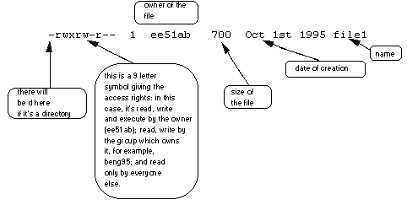
Hands-on
ls –l .The 9 remaining symbols indicate the permissions, or access rights, and are taken as three groups of 3.

Slide 36
Compressing files
gzip filename.txt
This will compress the file and place it in a file called filename.txt.gz
To expand the file, use the gunzip command.
gunzip filename.txt.gz

Slide 37
Thank you!

